Slide 1
Is aid effective?

Slide 2
Aid Effectiveness
Lecture Outline
(1) The theory of external aid and development – why give aid? – Agency Theory
(2) Is aid good for growth?
(3) Empirical Results of aid effectiveness

Slide 3
Aid Effectiveness
(1) The theory of external aid and development
Initial models assumed that aid contributed to the level of savings in the country.
In the Harrod-Domar model this is expected to positively effect investment, which in turn positively impacts on growth – so aid positively affects growth.
However what of the issue of the motivation for donor countries to give aid? Issue of fungibility and response of fiscal policy?

Slide 4
Aid Effectiveness
Literature on game-theoretic approach to the interplay between aid donors and beneficiaries (See Svensson, 1997, World Bank Policy research working paper, No. 1740; Collier et al 1997, World Development, Vol 25(9), pp. 1399-1407).
Agency theory used in Martens et al (2001) is a ‘type of institutional analysis’ that looks at the incentive problems that may occur in foreign aid that results in inefficient aid expenditure.
Agency theory same as principal agent theory – so have either moral hazard or adverse selection……..is about the need to delegate from the principal to the agent which means imperfect monitoring thus uncertainty……are these uncertainties (or errors) correlated?

Slide 5
Aid Effectiveness
In the donor-beneficiary relationship of foreign aid it is assumed the principal is the donor and agent the beneficiary.
As such “recipient compliance with the agreement is subject to moral hazard and adverse selection” (Martens et al 2001, pp. 12).
Moral hazard occurs when the beneficiary has an incentive to follow policies that advance themselves at the cost of the objectives of the donor aid agency.
Adverse selection is to do with asymmetric information which is assumed here to favour the beneficiary agency (agent) over the aid agency (principal) and which runs against the principal.

Slide 6
Aid Effectiveness
Repeat offenders will gain a poor reputation and other beneficiaries will be targeted by the aid agency – Will this not drive good behaviour and minimise moral hazard and adverse selection issues?
Issue then of realising whether or not other potential beneficiaries are any better…if not then simply pull out all aid to the country?

Slide 7
Aid Effectiveness
Moral Hazard – in recipient countries those agents who are meant to be directly benefiting from aid have a huge incentive to say it is making a difference, when they know it may not be.
Something is better than nothing for the agent; especially when it is being funding by an external source.
The benefactors of foreign aid thus have no incentive to inform the donor agency of concerns with the aid.
(Q) Who then is concerned about the efficiency of foreign aid?
(A) The donor country will be, and in particular those in charge of giving money…..politicians (principals within the donor country).

Slide 8
Aid Effectiveness
(Q) What about the financing of non governmental organisations (NGOs) as beneficiaries? – Are NGOs doing a good job?
(Q) Is direct action by aid agencies and foreign governments a better way of allocating aid?

Slide 9
Aid Effectiveness
(Q) Whilst the inefficiency concerns raised so far place the cause of this squarely at the door of the benefactor….are the international agencies and government aid departments efficient?
Aid agencies and NGOs suffer from having multiple principles, which brings with it multiple goals which are impossible to rank due to the different principles (members, individuals, politicians etc…) within the organisation having different objectives.
Crucially these differing objectives are likely to be inconsistent with each other – competing with each other given a budget constraint.
Within agency inefficiency.

Slide 10
Aid Effectiveness
On the questions of whether direct action by aid agencies and foreign governments is a better way of allocating aid there have been well documented criticisms of the World Bank regarding their effectiveness (i.e. the principal is inefficient).
Kanbur (2000) notes that
“representatives of the aid agencies in Africa, those who “parachute in” for missions of days and those who are resident locally, are the symbols of the power of the donor agencies….As they travel in convoys of four wheel drives to inspect projects funded by their agencies, and as they mingle on the diplomatic cocktail circuit, the resentment they evoke in the local population should not be underestimated”.
This is consistent with some beneficiary countries becoming hostile towards these agencies.
The World Bank and other large aid agencies should thus understand itself better as an institution and the impact it’s institutional foot print is having in countries where it is a major financial player (Kanbur, 2006, pp. 15).

Slide 11
Aid Effectiveness
Easily identified objectives, e.g. better access to water, electricity, homes…
However in accordance with the recent re-emergence about the role institutions play in growth and development there has been some movement towards aid spending on the benefactor’s institutions in order to improve efficiency…
Reform of institutions is far less tangible….indeed how do you measure this?
More likely that uncertainties occur and that issues of moral hazard and asymmetry of information problems will arise.
This brings us to the neo-institutionalism school of thought which differs from the neo-classical school of thought because, amongst other things, they assume that transaction costs are not zero or near zero but are actually very high.

Slide 12
Aid Effectiveness
Transaction costs include things like gathering information that will conclude a contract successfully.
If this information is not garnered then any contract that is agreed upon faces risks and uncertainty because of missing information.
Property rights theory analyses the allocation of this residual risk caused by missing information and how this affects behaviour of the agents involved.
Institutions (what Martens, 2001, pp. 10 calls ‘rules of behaviour’ but which is debatable within the non-economic literature of institutions) reduce uncertainty but the risk is always there.
This is one of the problems that development agencies face.

Slide 13
Aid Effectiveness
As alluded to previously though, aid agencies and NGOs face internal structural problems.
In the public sector and not-for-profit sector because of no incentives to take risks by workers (as opposed to the private sector where bonuses are awarded) decisions will take longer to make since it is not worth any public sector employee risking his/her position when there is no reward – they will make fewer decisions than private sector workers.
In the NGO sector there is a tendency for decisions to be made democratically after a discussion, so everyone’s voice is heard…..this can in itself increase the internal transaction costs to the NGO.

Slide 14
Aid Effectiveness
The interesting feature of the donor-recipient example of agency theory is that the taxpayers-donors (principals) do not benefit directly from the aid.
The aid may seem to be provided by the donor country taxpayers/voters for altruistic reasons.
According to Martens (2001, pp. 18) the people who benefit are those who approve programmes for political and commercial purposes:
“It explains, for instance, why the interests of domestic suppliers of aid goods and services – consultancy companies, experts, suppliers of goods – dominate decisions making: they are the direct beneficiaries of aid (they receive the contractually agreed reward) and have direct leverage on domestic political decision-makers”.

Slide 15
Aid Effectiveness
So, ultimately because of informational problems and of powerful donor country interests that can lever aid packages that ultimately benefit themselves and NOT the recipient country aid itself can be ineffective and result in recipient countries receiving aid that is at worst damaging (e.g. to the environment).
(Q) What is the point of aid when the expected recipient has little/no input into the decision making process?

Slide 16
Aid Effectiveness
The reality of aid though is that it is given to the recipient country’s government (McGillivray and Morrissey, 2001, pp. 1).
The next step is how the aid will be spent by government bearing in mind the donor country’s stipulations on aid.
This has resulted in a series of ‘fungibility’ studies in which the recipient country’s spending of aid is researched in relation to what the aid was meant to be spent on. We return to these studies in the empirical part of the lecture.
But there are other questions about the effects of aid on a recipient country…………

Slide 17
Aid Effectiveness
(Q1) Will aid change the behaviour of government fiscal policy? e.g. will aid subsidise the education sector meaning government does not need (or thinks it does not need) as much government spending in this sector?
(Q2) Will aid result in a budget surplus, i.e. a savings increase by government? If so, then will this surplus be spent on other things or be used to reduce taxes?
(Q3) Will aid impact on growth?

Slide 18
Aid Effectiveness
(2) Is Aid good for Growth?
This question has been asked since the early 1960s, with developments in mainstream economics being directly relevant to the answer given – this has generated some debate.
During the 1960s and early 1970s it was commonly held that in a Harrod-Domar economic growth model that “savings are substantially determined by government policy and that a government’s saving effort will be less vigorous if greater foreign resources are available”, (Patanek, 1972, pp. 936).
For the Harrod-Domar growth model (and the later simple Solow model), investment was seen as the key direct driver/determinant of growth.

Slide 19

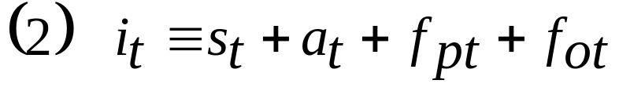
Aid Effectiveness
If savings are determined by (i) government policy and effort, (ii) by a given expected growth rate that was itself determined by a fixed level of investment, then any foreign inflows that includes aid will necessarily require a reduction in savings achieved by a change in government savings policy……..in the Harrod-Domar model.
Formally in a closed economy Harrod-Domar model the investment ratio=savings ratio,
However, in an open economy foreign funds are included in the model so that,

Slide 20
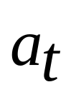
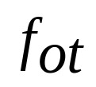

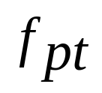
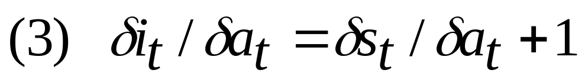
Aid Effectiveness
where, represents total Aid as proportion of Y,
is other foreign transfers and is private foreign transfers.
We are concerned with the impact Aid has on savings and in this model, investment too.
If we assume that aid has no impact on private and other foreign inflows, then the marginal effect of aid on investment is:

Slide 21
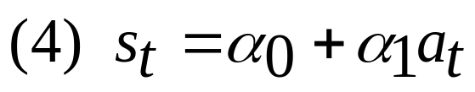
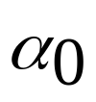

Aid Effectiveness
Aid will have an impact on domestic savings and by implication of the Harrod-Domar model will also impact on the investment ratio – this will clearly have implications for growth.
Early attempts to measure the impact of aid on savings was to estimate the following regression,
where represents the marginal rate of savings and the impact aid inflows has on savings.
It was not clear though what sign would take.

Slide 22
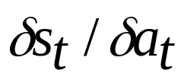
Aid Effectiveness
The debate on the sign of raged and early surveys indicated that was negative.
In terms of Equation (3) is equal to .
But from Equation (3) it is clear that what should be taken into account is the ‘1’…..so if the coefficient on is negative and between 0 and -1 then the overall impact of the rate of aid inflows on the savings rate and investment will actually be +ve.
Only if the coefficient is less than -1 will aid have a negative impact on savings and investment.

Slide 23
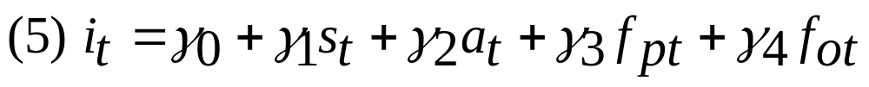
Aid Effectiveness
The empirical review of early studies on the relationship between savings, investment and aid will be undertaken in part 3 of the lecture.
The next step in the effect of aid was to study the impact the other factors in Equation (2) were having on investment and ultimately growth.
The basic idea was that rather than testing the relationship between aid and savings that the impact of all 4 factors in Equation (2) should be controlled for so that instead of estimating Equation (4) researchers should estimate,

Slide 24
Aid Effectiveness
Advancements to estimate this equation included:
  random and fixed effects econometric models
  the availability of panel data sets
  endogenous growth theory
Further research indicated the importance of institutions, the quality of institutions and the need to control for the government policies within and across countries.

Slide 25
Aid Effectiveness
(3) Empirical Results for Aid Effectiveness
We will concentrate on:-
(i) Where is aid spent – fungibility studies
(ii) Fiscal Response Models
(iii) The impact aid has on growth

Slide 26
Aid Effectiveness
(i) Fungibility Studies
The idea here is to estimate how much of the aid is spent on things (categories) that it was not intended for.
The theoretical foundation of these types of studies is that the recipient country wants to maximise it’s utility function subject to a budget constraint comprised of revenue and aid. See Feyzioglu et al (1998) or McGillivray and Morrissey (2001) for more detail.
Results in Table 2 from a number of fungibility studies indicate no firm conclusions.

Slide 27
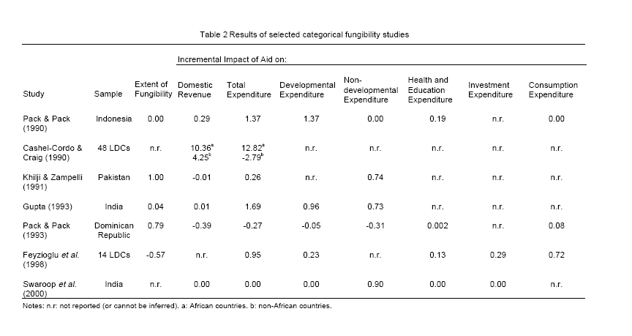
Aid Effectiveness
Taken from McGillivray and Morrissey (2001, pp. 8)

Slide 28
Aid Effectiveness
E.g. There is no fungibility found by Pack and Pack (1980). There is complete fungibility in Pakistan according to Khilji and Zampelli (1991).
One problem with the studies is that there is no information on where aid had been ear-marked for.
The studies are inconclusive but McGillivray and Morrissey (2001) argue that donor countries do not have complete control over where aid is spent but they do have a significant say.
Problems with fungibility studies include; that non-fungible expenditure of aid has no impact on the choice of government expenditure funded by tax revenues………..this is clearly unrealistic – e.g. if non-fungible aid spending on healthcare provision then this will ‘free-up’ resources for other government spending categories such as defence, energy research…..government changes it’s behaviour!

Slide 29
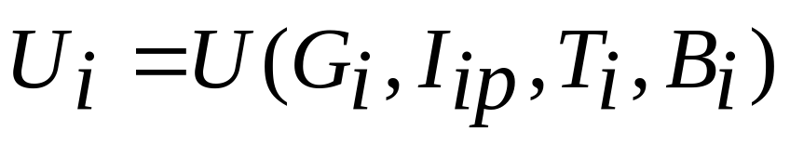
Aid Effectiveness
Instead of using fungibility studies an alternative is to look at the role aid can play in government expenditure and tax revenues and ultimately on the government’s budget.
(ii) Fiscal Response Modelling
The theory is similar to the fungibility models in that government policy makers aim to maximise a utility function,
where G is government expenditure, I is public sector investment expenditure, T is re-current taxation revenue and B is borrowing.

Slide 30
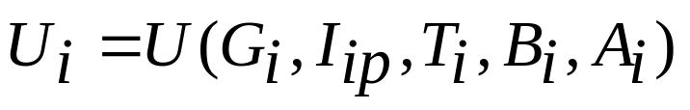
Aid Effectiveness
In this simple framework aid is assumed to be exogenous and utility is maximised subject to a budget constraint (that includes aid), with aid also constraining government consumption and government investment.
(Q) However, is aid really exogenous?
A recipient country is likely to court donor countries for aid and thus will have an expected minimum amount of aid revenue that can impact on G, I, T and B –thus aid needs to be considered endogenous in the utility function. Hence the utility function is given as:
“Recipients do have large degrees of choice over the amount disbursed, and hence allocated among expenditure categories. Consequently, it is appropriate to treat disbursed aid as an endogenous variable”, McGillivray and Morrissey (2001, pp. 14).

Slide 31
Aid Effectiveness
Unfortunately there are very few studies that look at the fiscal response of recipient countries when there are expected aid inflows – needs further work.

Slide 32
Aid Effectiveness
(iii) The Impact Aid has on Growth
Is a mainstream view from various economic studies that aid-growth effects are limited/non-existent.
The impact of aid has been evaluated at the micro and macro level, cross-country and single-country case study level and finally using qualitative, quantitative and inter-disciplinary approaches.
Here we concentrate on Hansen and Tarp (1999) who analyse aid effectiveness through macroeconomic variables (e.g. growth, investment and savings).
They attempt to refute the claim by Michalopoulos and Sukhatme (1989) and White (1992) that micro-economic and macroeconomic findings of aid effectiveness are contradictory, i.e. that microeconomic findings support the effectiveness of aid and that macroeconomic findings find no significant effect.

Slide 33
Aid Effectiveness
Empirical results taken from Hansen and Tarp (1999, pp. 30) indicate that aid has a non-linear relationship with growth.
Aid positively affects growth but at a decreasing rate as indicated by the +ve coefficient on aid and –ve coefficient on aid-squared.
Reasons for a priori expecting a non-linear relationship between aid and growth include the argument that in sub-Saharan African countries there may be a limited capacity to absorb foreign resources (e.g. unskilled labour force, uneducated, geographic isolation).
Also may be Dutch disease problems.
See the non-linear GDP-Aid relationship in columns 1,2 and 4 in Table 3 below….

Slide 34
Aid Effectiveness
Column 3 (Burnside and Dollar) find a –ve effect of aid on growth but include in the model an interaction term for aid x policy.
Interpretation on this interaction term is that the effectiveness of aid on the growth of a country is directly reliant on the quality of economic policies.
So in an environment of ‘good’ economic policies (i.e. inflation controlled, trade openness and budget deficit) aid has a positive effect of growth.
The implication is for developing countries to firstly get good macro-economic policies in place in order to increase the return on aid by donor countries.

Slide 35
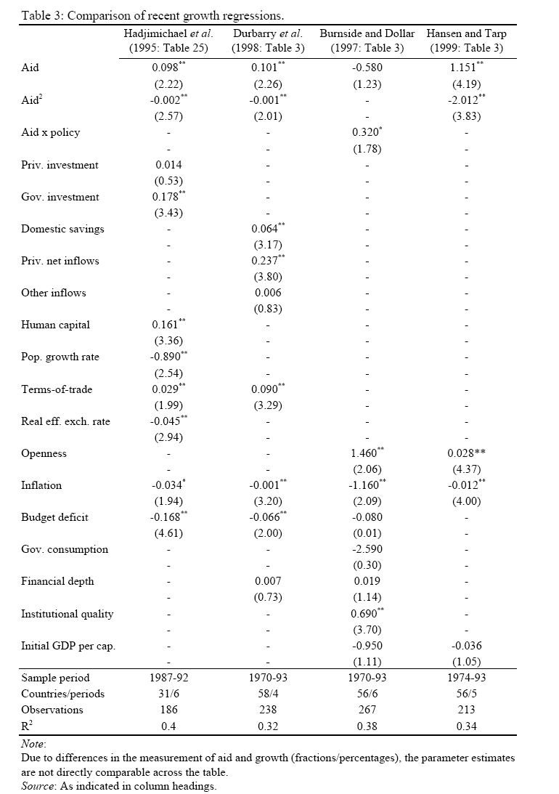

Slide 36
Aid Effectiveness
However, when regressions are run that include aid, aid-squared and the aid x policy interaction term (See Table 4 below) it is found that the non-linearity results dominate the aid and policy interaction result.
So Burnside and Dollar’s results are at best very tentative and are not robust when other variables are included in the growth model – a problem with many applied economic papers.

Slide 37
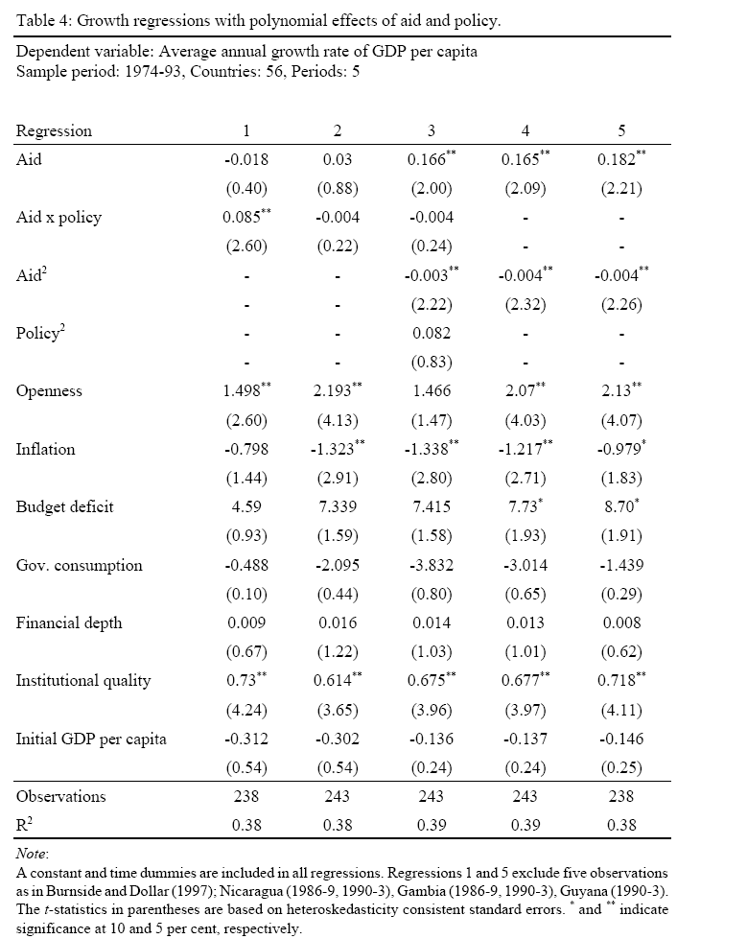

Slide 38
References
Svensson, (1997), World Bank Policy research working paper, No. 1740
Collier et al (1997), World Development, Vol 25(9), pp. 1399-1407
Martens, B., (2002), The Institutional Economics of Foreign Aid, Cambridge University Press. Chapter 1, pp.1-32.
Recommended Reading: Aid and Growth Evidence
Patanek, (1972), “The Effect of Aid and other resource transfers on savings and growth in less developed countries”, Economic Journal, September pp. 934-950.
World Bank (1998), Assessing Aid: What Works, What Doesn’t and Why?, Oxford University Press for the World Bank. http://www.worldbank.org/research/aid/aidpub.htm
Hansen, H. and F. Tarp (1999), “Aid Effectiveness Disputed” http://www.econ.ku.dk/derg/papers/Aid_Effectiveness_Disputed.pdf
McGillivray, M. and O. Morrissey (2000) “Aid Fungibility in Assessing Aid: Red Herring or True Concern?”, Journal of International Development, 12:3, 413-428.
McGillivray, M. and O. Morrissey (2001a) “Aid Illusion and Public Sector Fiscal Behaviour” Journal of Development Studies, 37:6, 118-136.
McGillivray, M. and O. Morrissey (2001b), “Fiscal Effects of Aid”, WIDER Discussion Paper WDP 2001/61. http://www.wider.unu.edu/publications/dps/dp2001-61.pdf
Kanbur, R., (2000), “Aid, Conditionality and Debt in Africa”, in F.Tarp (ed), Foreign Aid and Development: Lessons and Directions for the Future, Routledge. Go to http://www.people.cornell.edu/pages/sk145/papers/africaaid.pdf

